Slide 1

Notes:
Cover Slide

Slide 2



Blood relations Quiz:
https://qrgo.page.link/2TMbf

Slide 3
RATIOS AND PROPORTIONS

Slide 4
RATIOS:
A ratio is a relationship between two numbers indicating how many times the first number contains the second.
For example, if a bowl of fruit contains eight oranges and six lemons, then the ratio of oranges to lemons is eight to six (that is, 8∶6, which is equivalent to the ratio 4∶3).

Slide 5
PROPORTIONS:
A proportion is simply a statement that two ratios are equal. It can be written in two ways: as two equal fractions a/b = c/d; or using a colon, a:b = c:d. ...
In problems involving proportions, we can use cross products to test whether two ratios are equal and form a proportion.
A proportion is an equation with a ratio on each side. It is a statement that two ratios are equal. 3/4 = 6/8 is an example of a proportion.

Slide 6
FORMULA:
If u/v = x/y, then uy = vx
If u/v = x/y, then u/x = v/y
If u/v = x/y, then v/u = y/x
If u/v = x/y, then (u+v)/v = (x+y)/y
If u/v = x/y, then (u-v)/v = (x-y)/y
If u/v = x/y, then (u+v)/ (u-v) = (x+y)/(x-y), which is known as componendo -Dividendo Rule
If u/v = v/x, then u/x = u²/v²
If u/v = x/y, then u = x and v =y
If a/(b+c) = b/(c+a) = c/(a+b) and a+b+ c ≠0, then a =b = c

Slide 7
CONCEPTS:
Suppose we have two quantities or two numbers or two entities and
we have to find the ratio of these two, then the formula for ratio is defined as;
a: b ⇒ a/b
where a and b could be any two quantities.
Here, “a” is called the first term or antecedent, and “b” is called the second term
or consequent.
Now, let us assume that, in proportion, the two ratios are a:b & c:d.
The two terms ‘b’ and ‘c’ are called ‘means or mean term,’
whereas the terms ‘a’ and ‘d’ are known as ‘extremes or extreme terms.’
a/b = c/d or a : b :: c : d

Slide 8
Question :1
Are the ratios 4:5 and 8:10 said to be in Proportion?
A. YES
B. NO
Answer: A

Slide 9
Solution:
4:5= 4/5 = 0.8 and 8: 10= 8/10= 0.8
Since both the ratios are equal, they are said to be in proportion.

Slide 10
Question: 2
Are the two ratios 8:10 and 7:10 in proportion?
A. YES
B. NO
Answer: B

Slide 11
Solution:
8:10= 8/10= 0.8 and 7:10= 7/10= 0.7
Since both the ratios are not equal, they are not in proportion.

Slide 12
Question: 3
Given ratios are → a:b = 2:3, b:c = 5:2, c:d = 1:4 Find a: b: c:d.
10:15:6:24
10:6:15:24
6:15:10:24
24:6:10:15
Answer: A

Slide 13
Solution:
Multiplying the first ratio by 5, second by 3 and third by 6, we have
a:b = 10: 15
b:c = 15 : 6
c:d = 6 : 24
In the ratio’s above, all the mean terms are equal, thus
a:b:c:d = 10:15:6:24

Slide 14
Question: 4
Divide Rs. 90 in ratio 1:2 between Ram and Karan.
Rs.30 and Rs.60
Rs.60 and Rs.30
Rs.45 and Rs.45
Rs.80 and Rs.10
Answer: A

Slide 15
Solution:
There are two parts, 1 and 2, the sum of which is 3 parts. Hence among the 3 parts, Karan gets 2 and Ram gets 1.
Therefore for 90 Rs (considered equivalent to 3 parts here)
Karan’s share = 2/3 ×90 = Rs.60
Ram’s share = 1/3 ×90 = Rs.30

Slide 16
Question: 5
Two numbers are respectively 20% and 50% more than a third number.The ratio of the two numbers is ________.
5:4
4:5
6:7
7:6
Answer: B
Notes:
This is the template for slides with only a bullet list

Slide 17

Solution:
Let the third number be x.
Then, first number=120% of x=120x/100=6x/5
Second number =150% of x=150x/100=3x/2
Ratio of first two numbers=
Notes:
This is the template for slides with only a bullet list

Slide 18
Question: 6
A sum of money is to be distributed among A, B, C, D in the proportion of
5 : 2 : 4 : 3. If C gets Rs. 1000 more than D, what is B's share?
Rs.500
Rs.1500
Rs.2000
None of these
Answer: C
Notes:
This is the template for slides with only a bullet list

Slide 19
Solution:
Let the shares of A, B, C and D be Rs.5x,Rs.2x,Rs.4x,Rs.3x
Then 4x-3x=1000
X=1000
So.B’s share=2*1000=2000
Notes:
This is the template for slides with only a bullet list

Slide 20
Question: 7
Seats for Mathematics, Physics and Biology in a school are in the ratio 5 : 7 : 8. There is a proposal to increase these seats by 40%, 50% and 75% respectively. What will be the ratio of increased seats?
2:3:4
6:7:8
6:8:9
None of These
Answer: A
Notes:
This is the template for slides with only a bullet list

Slide 21
Solution:
Originally, let the number of seats for Mathematics, Physics and Biology be5x,7x and 8x respectively.
Number of increased seats are (140% of 5x) ,(150% of 7x) and (175% of 8x)
(140/100 x 5x),(150/100 x 7x),(175/100 x 8x)
7x.21x/2 and 14x
The required ratio is 7x:21x/2:14x
14x:21x:28x=2:3:4
Notes:
This is the template for slides with only a bullet list

Slide 22
Question: 8
In a mixture 60 litres, the ratio of milk and water is 2 : 1. If this ratio is to be 1 : 2, then the quantity of water to be further added is __________.
20litres
30litres
40litres
60litres
Answer: D
Notes:
This is the template for slides with only a bullet list

Slide 23
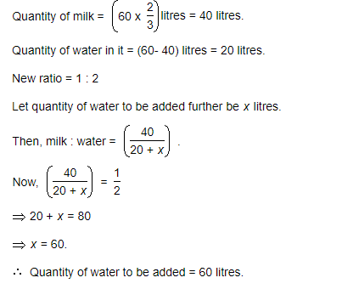
Solution:
Notes:
This is the template for slides with only a bullet list

Slide 24
Question: 9
The ratio of the number of boys and girls in a college is 7 : 8. If the percentage increase in the number of boys and girls be 20% and 10% respectively, what will be the new ratio?
8:9
17:18
21:22
Cannot be determined
Answer: C
Notes:
This is the template for slides with only a bullet list

Slide 25
Solution:
Originally, let the number of boys and girls in the college be 7x and 8x .
Their increased number is (120% of 7x),(110% of 8x)
(120/100 x7x) and (110/100 x 8x)
(42x/5) and (44x/5)
The required ratio is (42x/5:44x/5)=(21:22)
Notes:
This is the template for slides with only a bullet list

Slide 26
Question: 10
Salaries of Ravi and Summit are in the ratio 2 : 3. If the salary of each is increased by Rs. 4000, the new ratio becomes 40 : 57. What is Summit's salary?
Rs. 17,000
Rs. 20,000
Rs. 25,500
Rs. 38,000
Answer: D
Notes:
This is the template for slides with only a bullet list

Slide 27
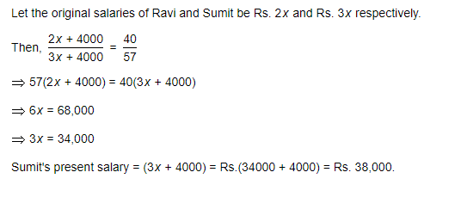
Solution:
Notes:
This is the template for slides with only a bullet list

Slide 28
Question: 11
The sum of three numbers is 98. If the ratio of the first to second is 2 :3 and that of the second to the third is 5 : 8, then the second number is __________.
20
30
48
58
Answer: B
Notes:
This is the template for slides with only a bullet list

Slide 29
Solution:
Let the three parts be A, B, C. Then,
A : B = 2 : 3 and B : C = 5 : 8 =(5 x 3/5) :(8 x 3/5)=(3:24/5)
A:B:C = 2:3:24/5 = 10:15:24
B=(98 x 15/49)=30
Notes:
This is the template for slides with only a bullet list

Slide 30
Question: 12
The salaries A, B, C are in the ratio 2 : 3 : 5. If the increments of 15%, 10% and 20% are allowed respectively in their salaries, then what will be new ratio of their salaries?
3:3:10
10:11:20
23:33:60
Cannot be determined
Answer: C
Notes:
This is the template for slides with only a bullet list

Slide 31
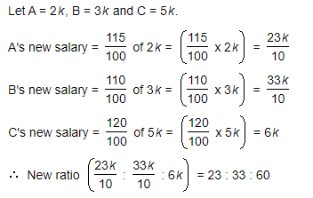
Solution:
Notes:
This is the template for slides with only a bullet list

Slide 32
Question: 13
If 40% of a number is equal to two-third of another number, what is the ratio of first number to the second number?
2:5
3:7
5:3
7:3
Answer: C
Notes:
This is the template for slides with only a bullet list

Slide 33
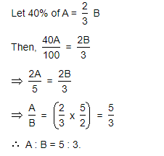
Solution:
Notes:
This is the template for slides with only a bullet list

Slide 34
Question: 14
The fourth proportional to 5, 8, 15 is ______.
18
24
19
20
Answer: B
Notes:
This is the template for slides with only a bullet list

Slide 35
Solution:
Let the fourth proportional to 5, 8, 15 be x
Then, 5:8:15:x
5x=(8x15)
X=24
Ans:24
Notes:
This is the template for slides with only a bullet list

Slide 36
Question: 15
Two number are in the ratio 3 : 5. If 9 is subtracted from each, the new numbers are in the ratio 12 : 23. The smaller number is ________.
27
33
49
55
Answer: B
Notes:
This is the template for slides with only a bullet list

Slide 37
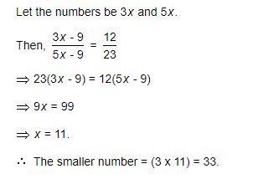
Solution:
Notes:
This is the template for slides with only a bullet list

